Slide 1
PV Access
Feb. 2022
Kay Kasemir
Python examples by Amanda Carpenter

Slide 2
EPICS Network Protocols
Channel Access
Since beginning of EPICS
DBR_*: Numbers, enums, string, scalar and array, with time, alarm, limits
Still fully supported
PV Access
Started as “EPICS V4” development
PV Data: Arbitrary structures
Since EPICS 7 (Dec. 2017) included in EPICS base

Slide 3
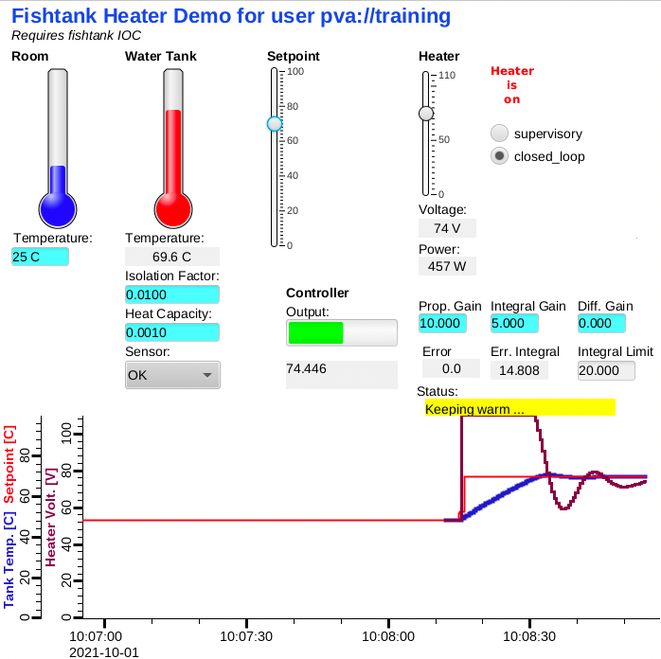
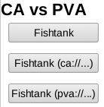
First Glance
softIocPVA instead of softIoc
# We did this before: cd /ics/examples/02_fishtank cat st.cmd # Compare, then run: cd /ics/examples/24_pvaccess cat st.cmd ./st.cmd
pv… instead of ca…
camonitor training:setpoint training:tank pvmonitor training:setpoint training:tank pvput training:setpoint 40 caput training:setpoint 30
CS-Stud﻿io:
css -resource /ics/examples/24_pvaccess/pva.bob

Slide 4
PV Access
Similar to Channel Access
Name search via UDP
Connection for data transfer via TCP
EPICS_PVA_ADDR_LIST, EPICS_PVA_AUTO_ADDR_LIST
Get, put, monitor
Plus an ‘RPC’ type operation
Arbitrary PV Data structures instead of DBR_.. types

Slide 5
Custom Data: Great, but then what?
Keith’s structure: short level double data string type time stamp …
Jürgen’s structure: short grad double wert string typ long zeit …
Fred’s structure: double value short status short severity string units time timeStamp …
Which number to show on a user display?
What units?
Is this an alarm?
Time stamp?
Jane’s structure: short info double content string meta long ms …

Slide 6
“Normative Types”
Channel Access
struct dbr_ctrl_double: short status short severity short precision char units[8] … no timestamp … double value struct dbr_time_double: short status short severity timestamp stamp double value
You get what you request (network always transfers complete struct)
PV Access
epics:nt/NTScalar: double value short status short severity string units time timeStamp …
You get what you request (but network only transfers changes)

Slide 7
Channel Access vs. PV Access
Similar command line tools:
caget training:tank
camonitor training:tank
cainfo training:tank
caget –d CTRL_DOUBLE training:tank # Not supported camonitor –d CTRL_DOUBLE training:tank
caget training:tank.SCAN
pvget training:tank
pvmonitor training:tank
pvinfo training:tank pvget –M raw training:tank
# Note first few updates! pvmonitor –M raw training:tank
pvget training:tank.SCAN

Slide 8
CS-Studio
Use pva://… prefix to select PV Access
Use ca://… prefix to select Channel Access
Set default in /ics/tools/phoebus/settings.ini

Slide 9
So it’s very similar, maybe more efficient…
What’s really new?
How about those custom structures?

Slide 10
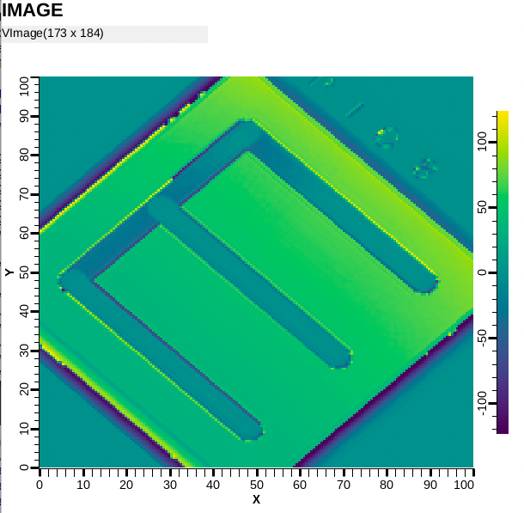
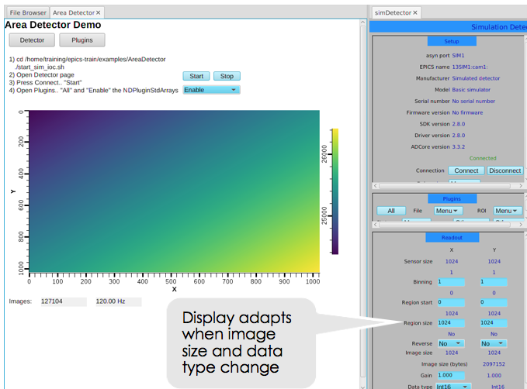
Images: Normative type NTNDArray
See Area Detector (NDPluginPVA) or cd /ics/examples/24_pv_access ./start_imagedemo
CS-Studio: Image widget
Only needs pva://ImagePV

Slide 11
Custom PV Data
SNS Beam Lines started to use this in ~2014
cd /ics/examples/24_pvaccess ./start_neutrondemo
pvinfo neutrons pvmonitor neutrons
Allows fetching just what’s needed:
# For detector pixel display pvget -r 'field(pixel)' neutrons pvmonitor -r 'field(timeStamp, pixel)' neutrons
# For energy displays pvmonitor -r 'field(time_of_flight, pixel)' neutrons

Slide 12
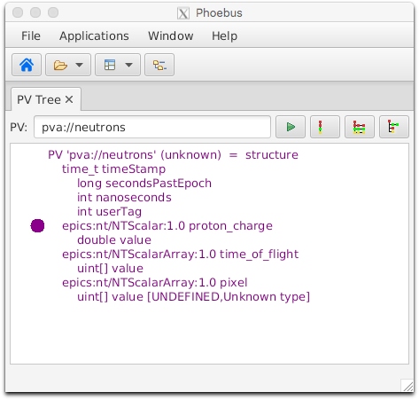
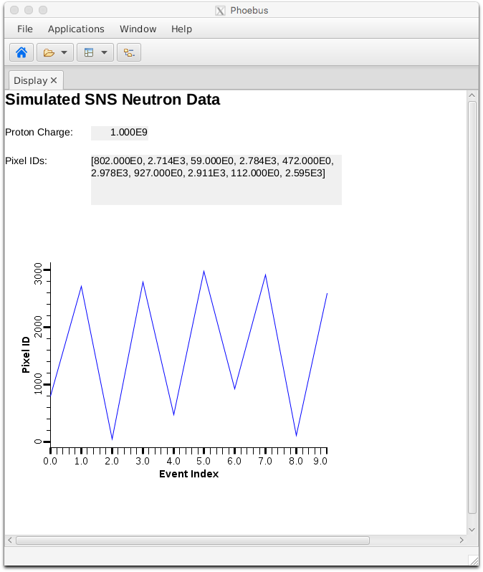
Custom PV Data in CS-Studio
Cannot handle arbitrary structure
pva://neutrons
Can handle fields which are scalar or array
pva://neutrons/proton_charge
pva://neutrons/pixel

Slide 13
PV Access and Python
Basic ‘get’, ‘put’, ‘monitor’
PV Access server for normative types or custom data
See *.py examples under
cd /ics/examples/24_pvaccess

Slide 14
Custom PV Data from IOC Records
`makeBaseApp.pl –t example` includes “group”, see /ics/examples/10_customApp/Db/circle.db, /ics/examples/iocBoot/ioc_custom
Calc records ..:circle:x & ..:circle:y compute (x, y) coordinate on circle
info() annotations create PV ”training:circle” PV as struct { angle, x, y }
PVA “training:circle” updates atomically
camonitor training:circle:x training:circle:y receives separate x, y updates pvmonitor training:circle will always see sqrt(x²+y²)==1
cd /ics/examples/24_pvaccess python circle.py

Slide 15
State of PV Access by end of 2021
Done, operational
Server and client libraries for C++, Java, Python
2nd version
Area Detector image transfer
Used to distribute processing from camera hosts
Custom data servers and clients
SNS: neutron data
APS: services
Done, to be tested
PV server for records in IOC
All record types
Full ‘units’
Support changing metadata
CS-Studio client
Gateway
To do
IOC links
“CP” links → PVA links
Channel Access Get/put callback → ??
How to best combine data from records into custom PVA data?

Slide 16
Summary: PV Access is ..
Update to Channel Access
Both can be used in parallel
Similar, but supports custom data types
Won’t replace IOC, but useful for special cases
Since EPICS 7 included in base IOC
Details of ‘group’, ‘field(…)’ access still evolving

